Slide 1
Signals of Energy Demand Progress Update
DIRECT Capstone Project, Spring 2019
Corey Johnson, Michelle Katz, Kai Ming Tao

Slide 2

CRISP-DM Structure
- Developed Business Understanding
EDA Complete for data understanding
Beginning Data Preparation and modeling

Slide 3
Objective (Business Need)
1. To create a publicly available database of energy consumption data for several different cities in the United States. The database will include energy consumption, demographic, and economic data for each city down to the zip code level.
2. Create a demonstration of the type of analysis that can be done with the dataset

Slide 4
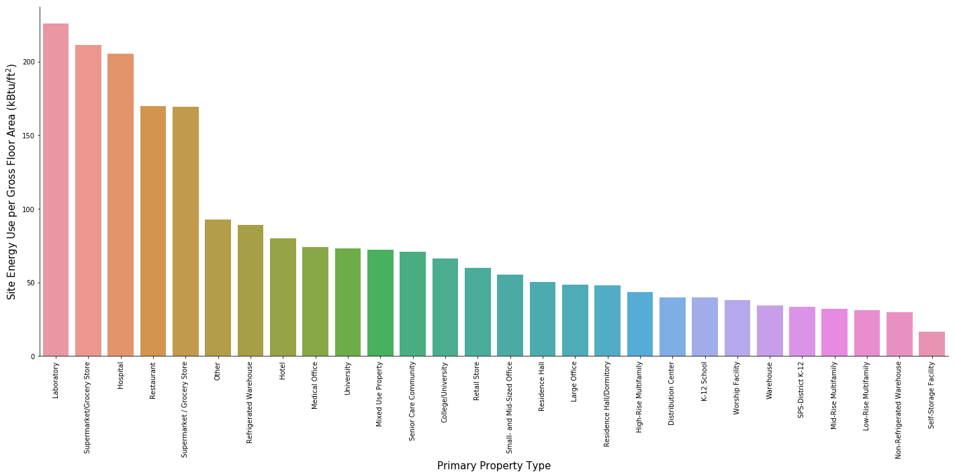
EDA (Data Understanding): Property Type

Slide 5
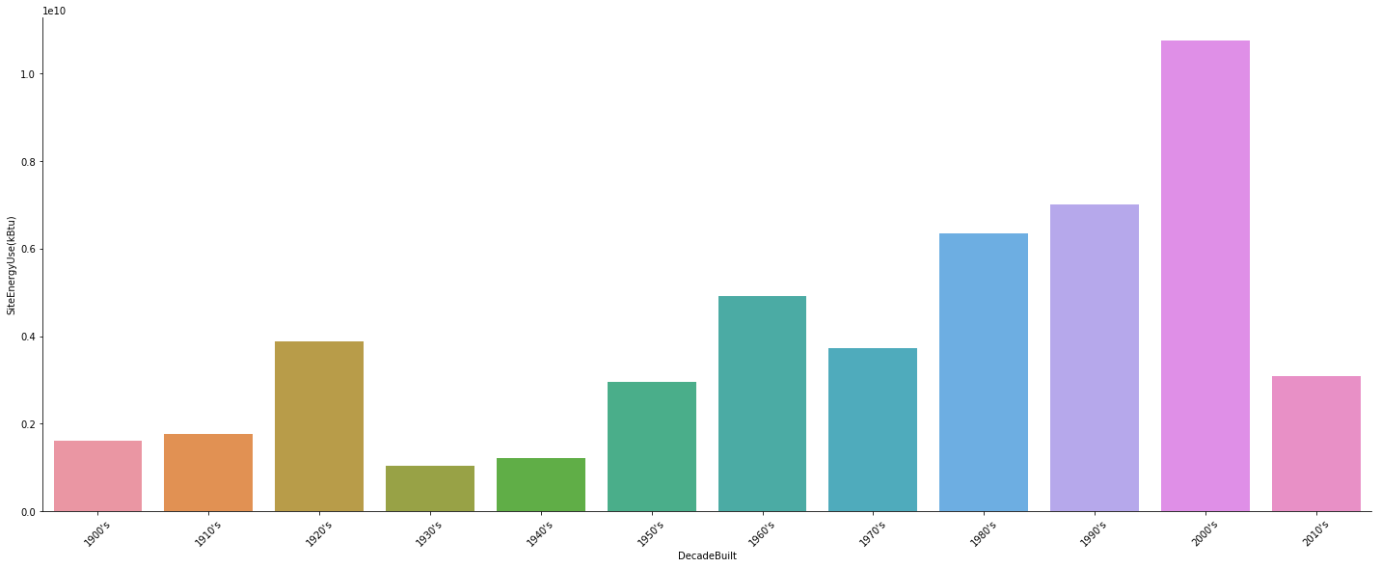
EDA: Decade Built

Slide 6
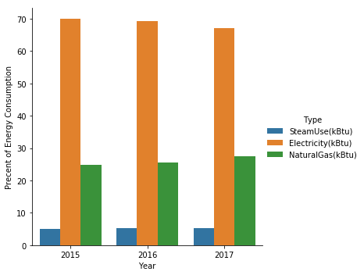
EDA: Energy Source

Slide 7
Entity Relationship Diagram
PK: Primary Key
FK: Foreign Key

Slide 8
Database Management Tools
Local Options: My SQL vs. PostGres
- MySQL Preferred due to Python interface and interaction with Google Cloud Platform
Will likely transfer to GCP after optimizing database

Slide 9
Python Visualization Packages – Tech Review
ggplot |  | seaborn
3,472 | Stars | 6,080
139 | Watchers | 235
549 | Forks | 984
over 3 years ago | Last Commit | about 1 month ago
 | More
L4 | Code Quality | L2
Python (Based on R and the grammar of graphics) | Language Grammar | Python (Based on Python matplotlib)
high-level interface Better Aesthetics | Appeals | high-level interface Better Aesthetics Easily customizable Aesthetics Easy to learn
Data Visualization, Scientific, Engineering | Tags | Data Visualization, Scientific, Engineering, Visualization, Multimedia, Graphics

Slide 10
Future Work
Familiarize with MySQL
Clean Data
Being organizing into database
Future Modeling: Relationship between energy consumption and various census data

